Slide 1
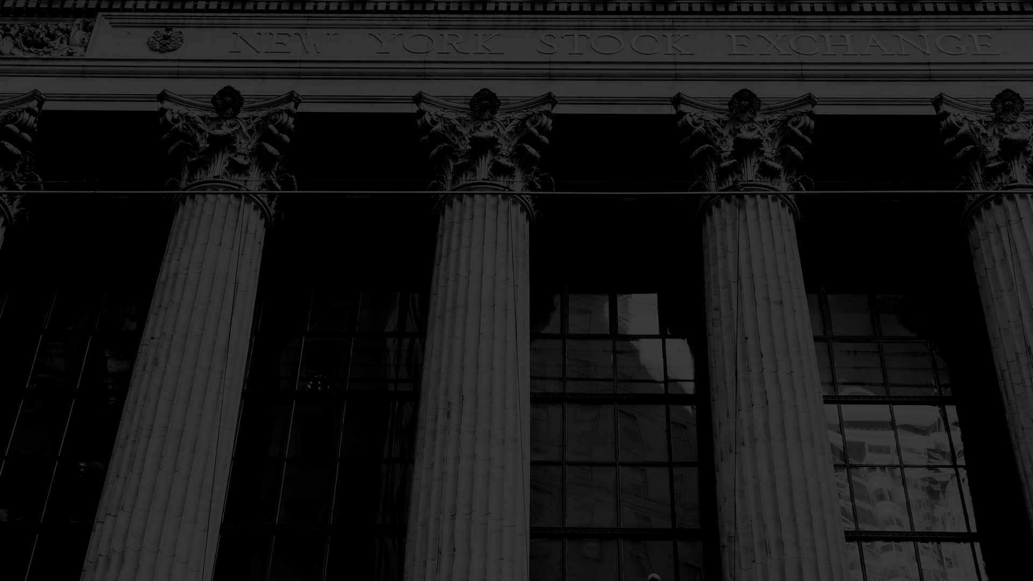
Fair Game:
An Analysis on Further Equalizing the Philippine Senatorial Elections
Team Pandas
Ale | Basty | Dale | Jolo | Kui | Rups
Notes:
> Influence of Campaign Expenditures to the Winnability of Political Candidates in Senatorial Elections
>

Slide 2

Flow
Problem Statement
Objectives
Datasets
Methodology
Results
Conclusion and Recommendation

Slide 3
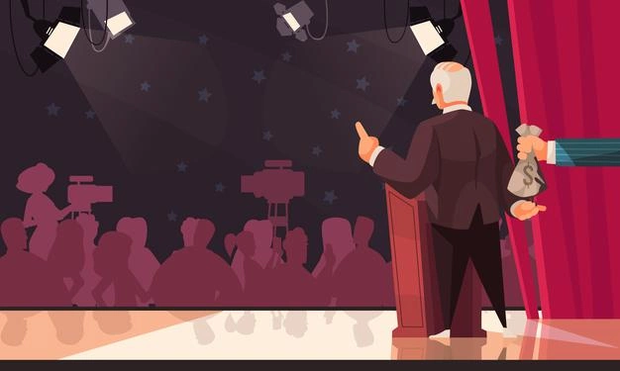
Election is one of the biggest manifestations of a democracy.
Gift vector created by macrovector - www.freepik.com
Notes:
[Ale]
Election is one of the biggest manifestations of a democracy. With elections, politicians supposedly derive their power from the people. However, the Philippine Center for Investigative Journalism found that candidates are mostly backed by a few wealthy donors. Do we truly live in a democratic society if our politicians may be beholden to special interests?

Slide 4

Problem Statement
How can we improve the Philippine Election System in terms of fairness for all candidates?
Notes:
[Rups]
However, the Philippine Center for Investigative Journalism found that candidates are mostly backed by a few wealthy donors. Do we truly live in a democratic society if our politicians may be beholden to special interests?
Knowing this, the group came up with the problem statement, “How can we improve the Philippine Election System in terms of fairness for all candidates?” -next slide
Our objective is to identify strategies or ways on reducing political spending disadvantages in senatorial elections.
Now, let’s look at the data used for this study.
Next Slide -- Objective
How can we improve the Philippine Election System in terms of fairness for all candidates?

Slide 5


Objective
To identify strategies on reducing political spending disadvantages in senatorial elections
Social media vector created by stories - www.freepik.com
Technology vector created by vectorjuice - www.freepik.com
Notes:
[ Rups]
Our objective is to identify strategies or ways on reducing political spending disadvantages in senatorial elections.
Now, let’s look at the data used for this study.
RECOMMENDATIONS
Government Funding
Spending Limitations
Political Ad Airtime allocation
Next Slide -- Datasets

Slide 6

S E T S
D A T A
Candidate Campaigns (2019)
Senatorial Votes (2019)
Candidate Name
Vote Count
Expenditure Breakdown
Social Media Interactions
Notes:
[Dale]
Next Slide -- Methodology

Slide 7
Methodology
Data
Preparation
Exploratory
Data Analysis
Feature Engineering
Data
Modelling
Cluster
Insights
01
02
03
04
05
Data cleaning and merging dataframes
Plotting and Correlation Analysis
Adding features
K-Means Clustering
Radar Analysis
Notes:
[Dale]
Next Slide -- Results

Slide 8
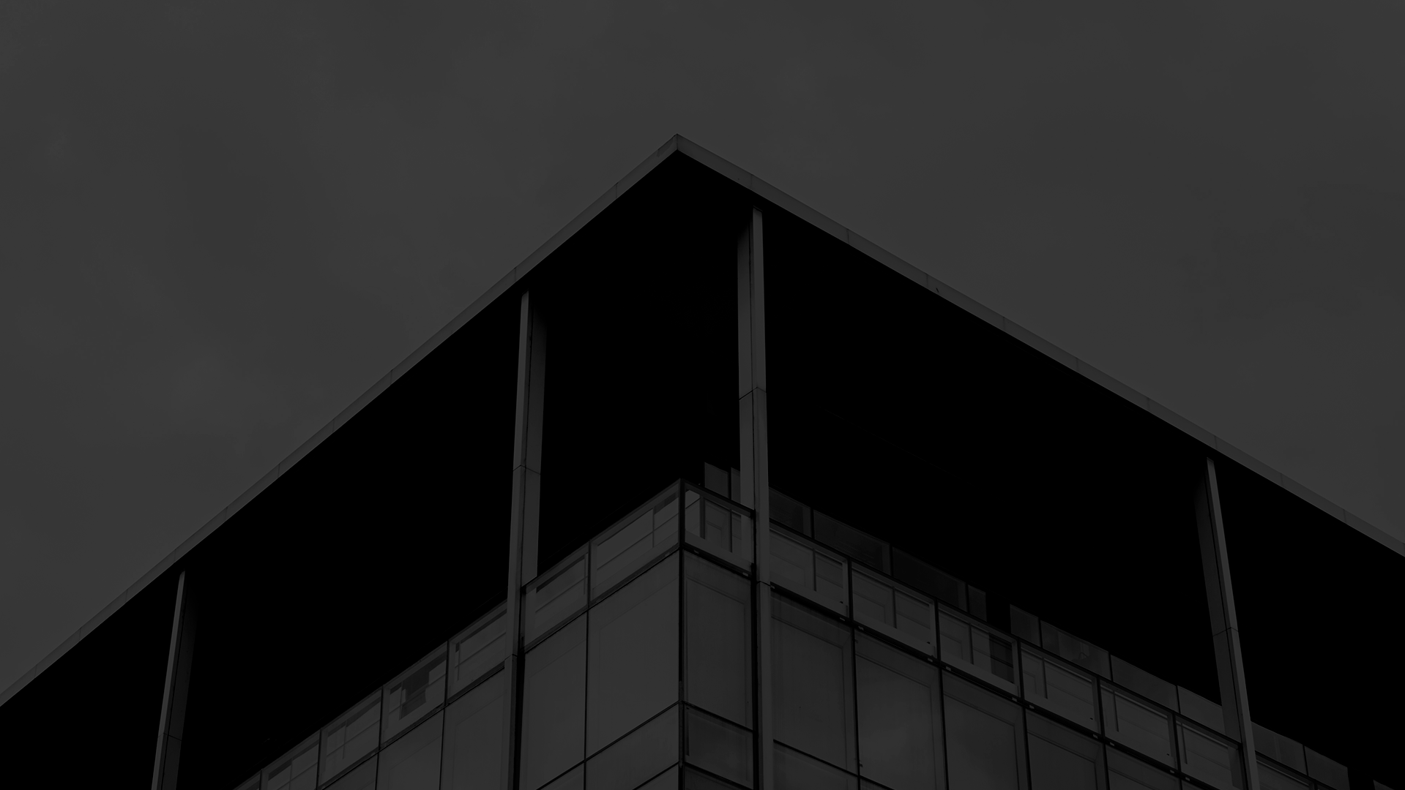
Results

Slide 9
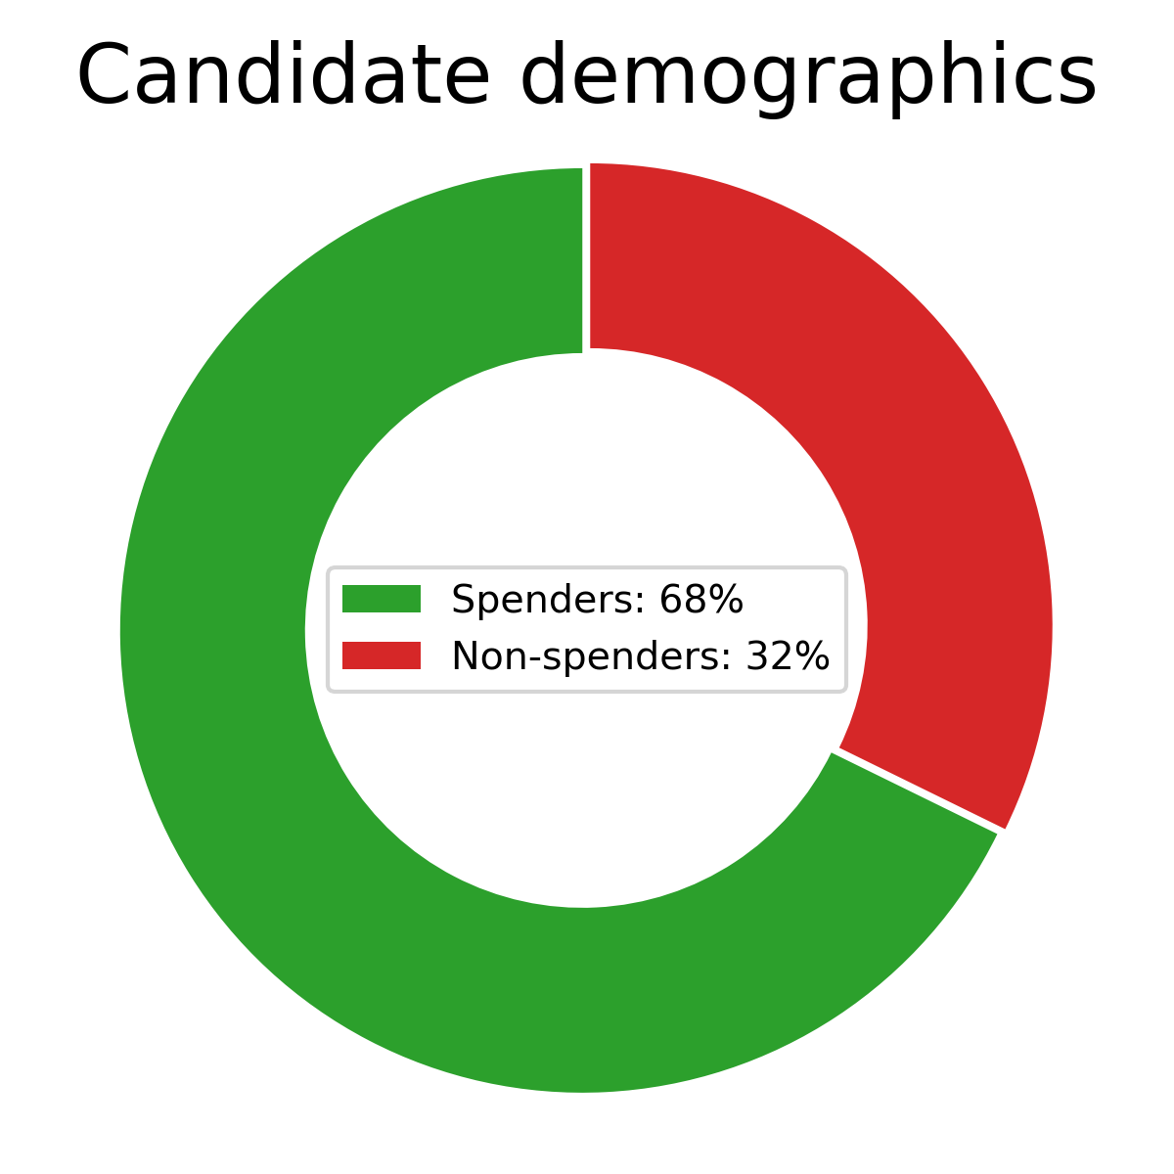
Insight on candidate demographics
All candidates who won the 2019 senatorial elections invested in their political campaigns (spenders).
However, some candidates did not have any financial support to utilize in their campaigns. (non-spenders).
Notes:
[Kui]
First, We classified candidates accdg to those who invested in their political campaigns (spenders), and those who did not spend any money on campaigns (non-spenders)
Majority of candidates were spenders, 68% of the total candidates, all winning candidates belong to this group.
We found out that all winning candidates were all spenders

Slide 10
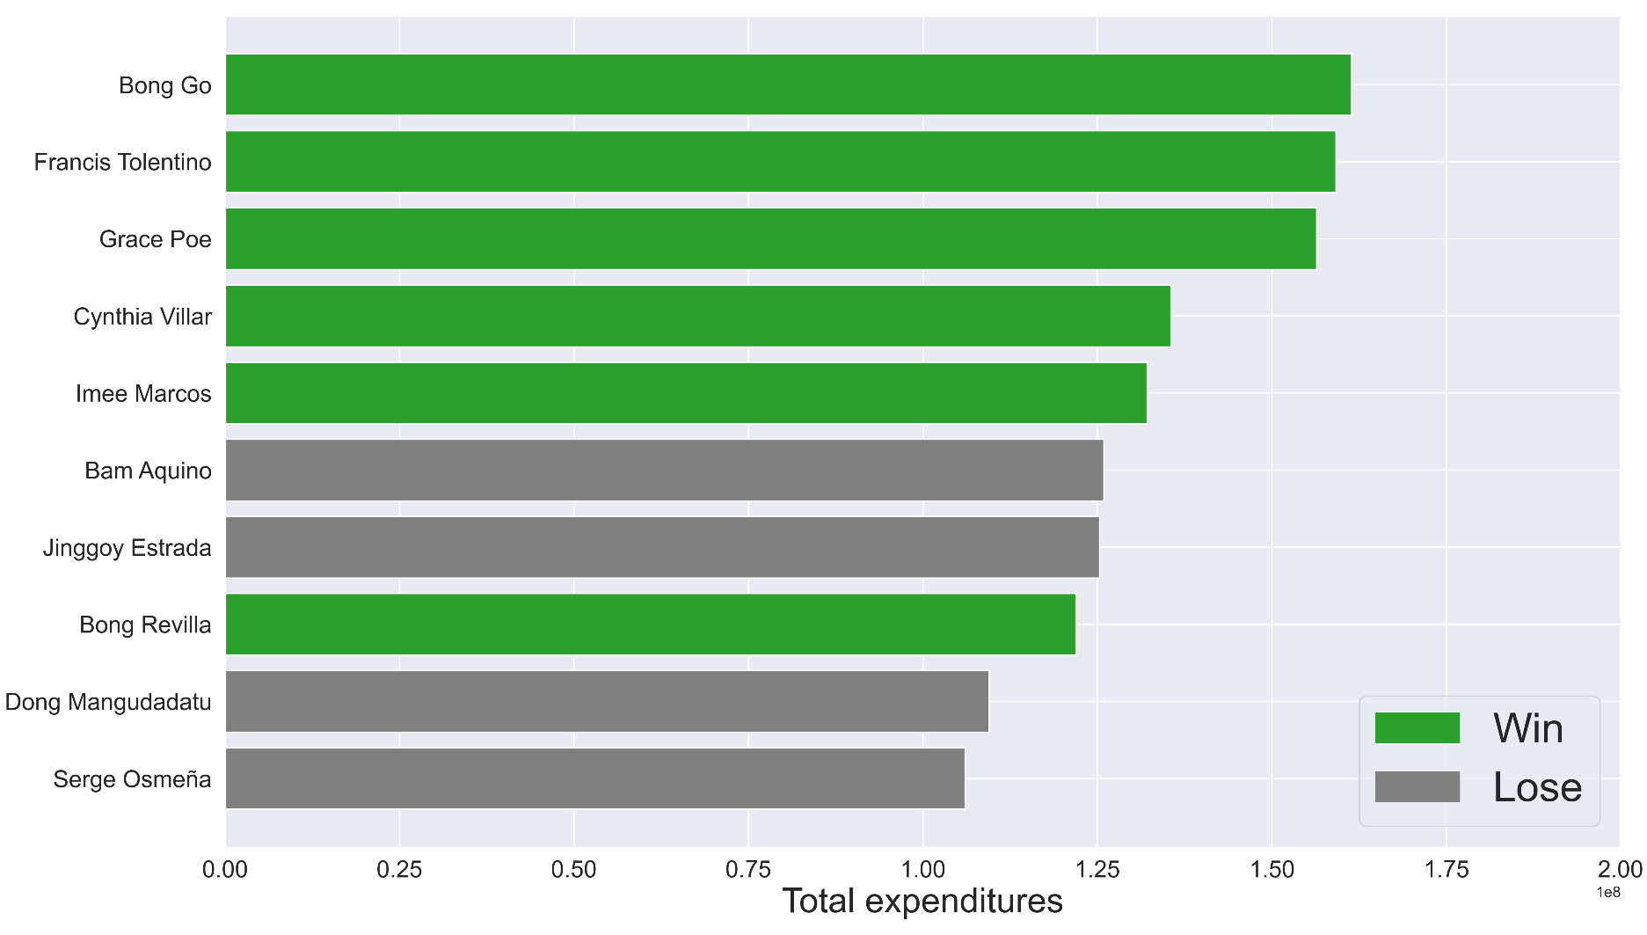
2019 Top Election Candidate Spenders
Fig 1. Total expenditures per candidate.
Notes:
60%

Slide 11
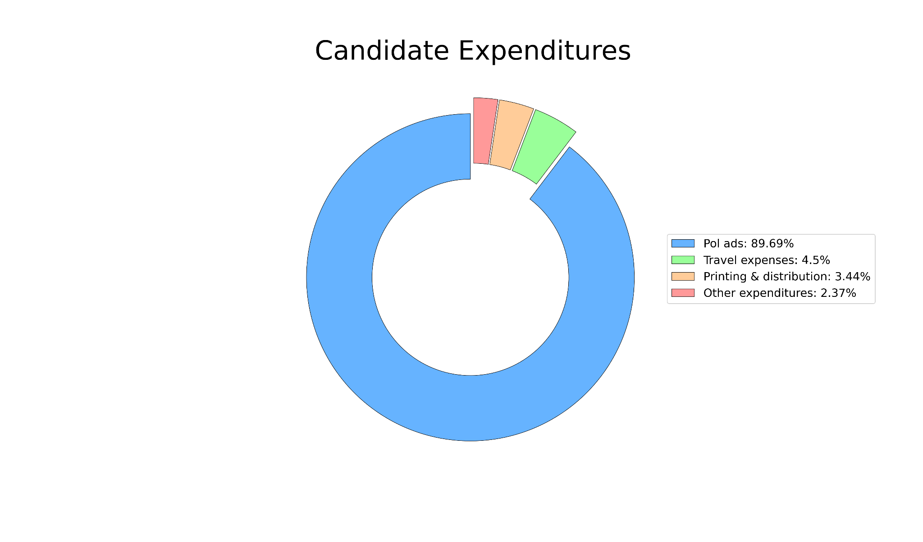
Insight on candidate spendings
Breakdown of candidate expenditures
The majority of candidates use political advertisements to reach out to voters.

Slide 12
Insight on candidate spendings
Breakdown of candidate expenditures
11 out of 12 of the winning candidates invested mainly in pol ads.
But does spending relate to candidate victory?
Notes:
[Kui]
Also, describe while presenting, how spenders potentially reach voters: pol ads, others might opt for travel to reach for voters.
11 out of 12 winning candidates invested in pol ads.

Slide 13
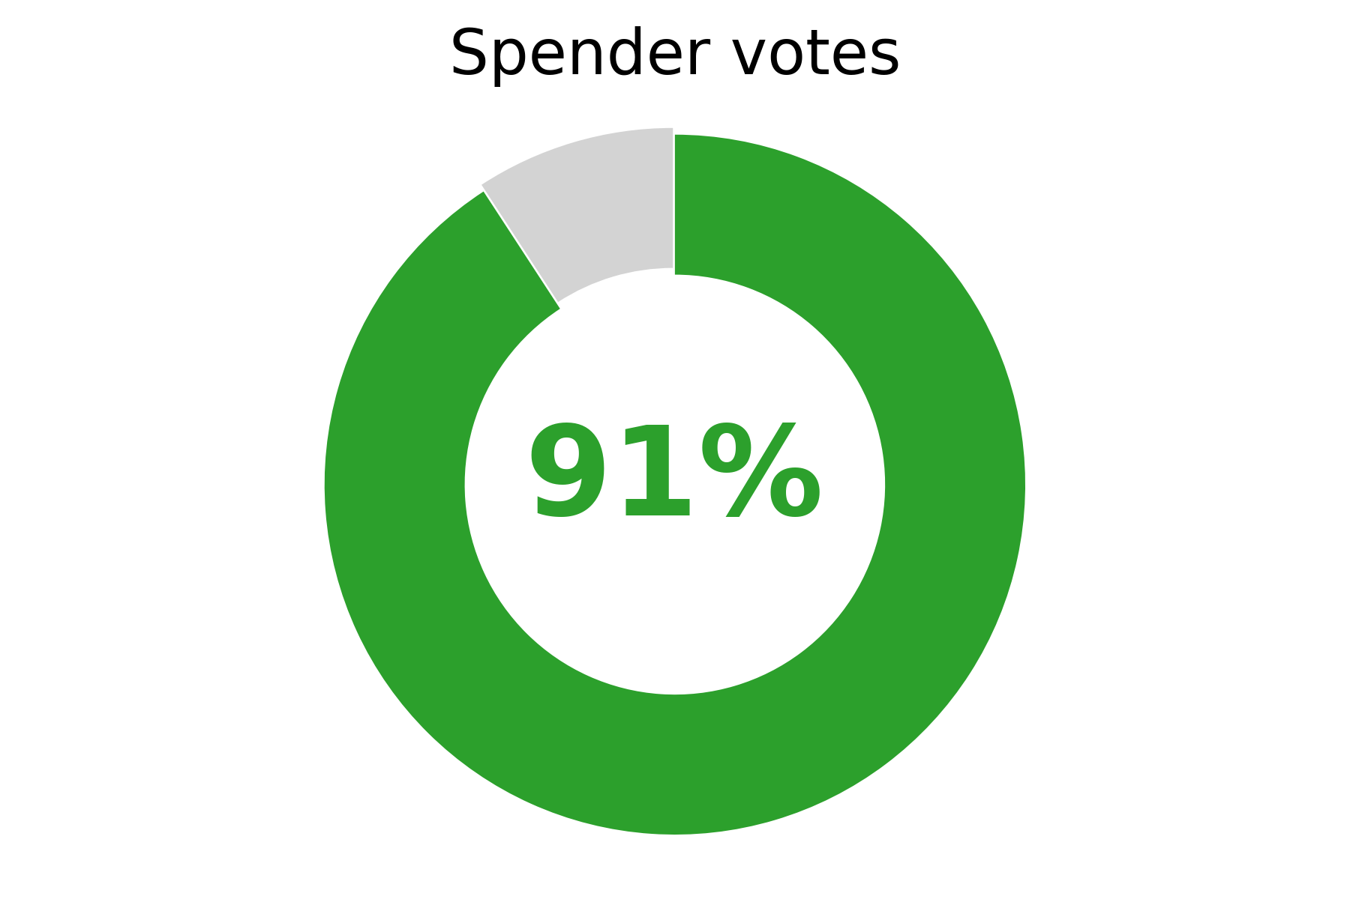
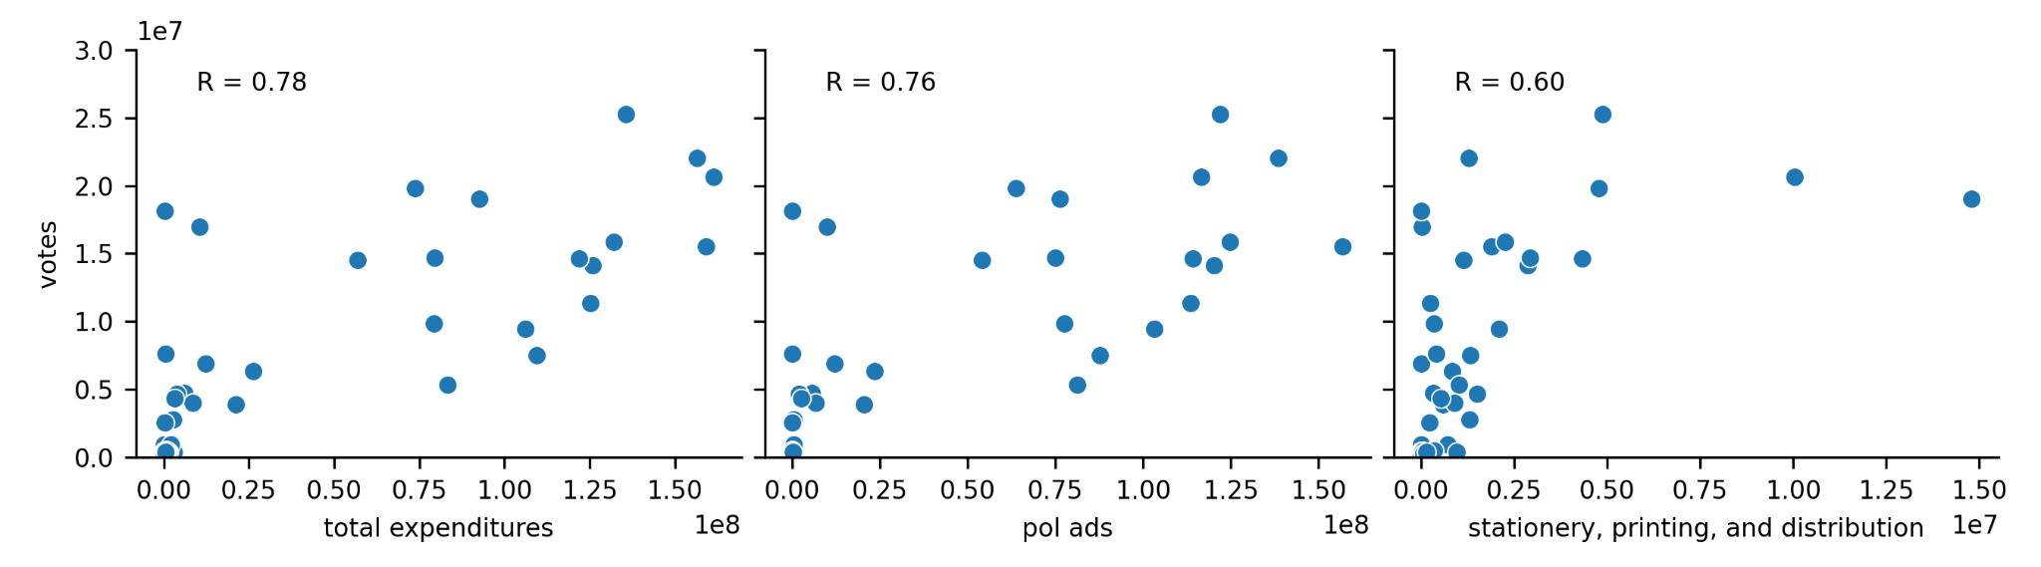
Potential factors contributing to spenders’ reach
Fig 2. Correlation of spender votes to different expenditures
Notes:
[Kui]

Slide 14
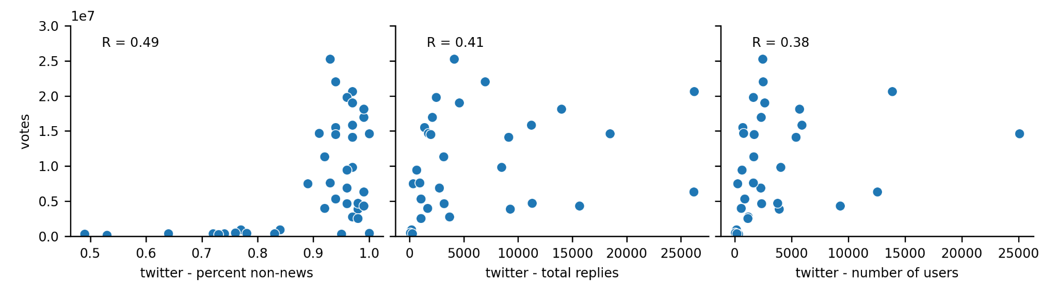
Potential factors contributing to spenders’ reach
Fig 2b. Correlation of spender votes to social media interactions.

Slide 15
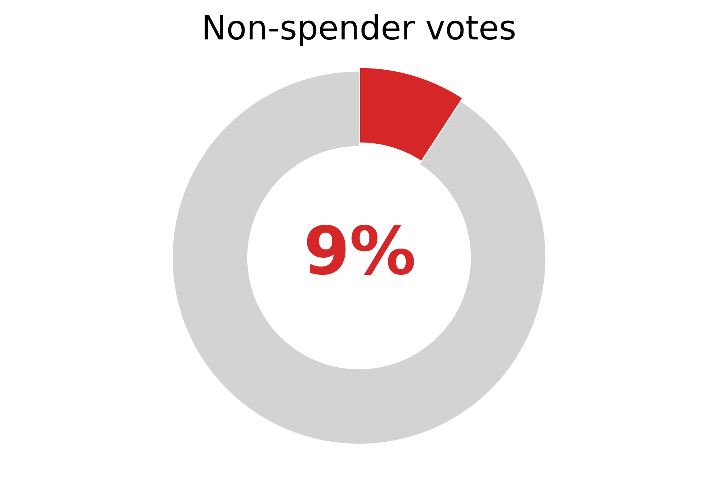
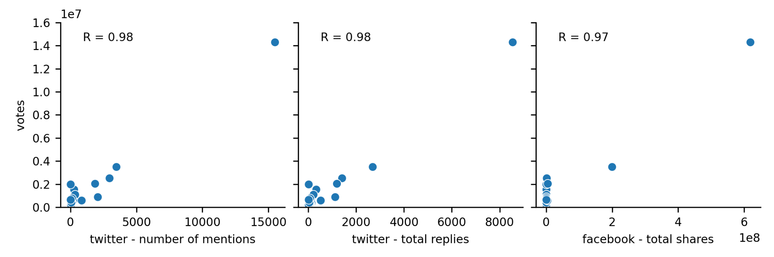
How did non-spenders establish voter reach?
Fig 3. Correlation of non-spender votes to social media interactions.
Notes:
[Jolo]
How did non-spenders establish voters reach?
9% of the non-spender votes are associated with the social media interactions.
The number of votes had a high correlation to the social media interactions.
With the lack of financial resources, we see that non-spenders compensated by reaching out to voters through social media.

Slide 16
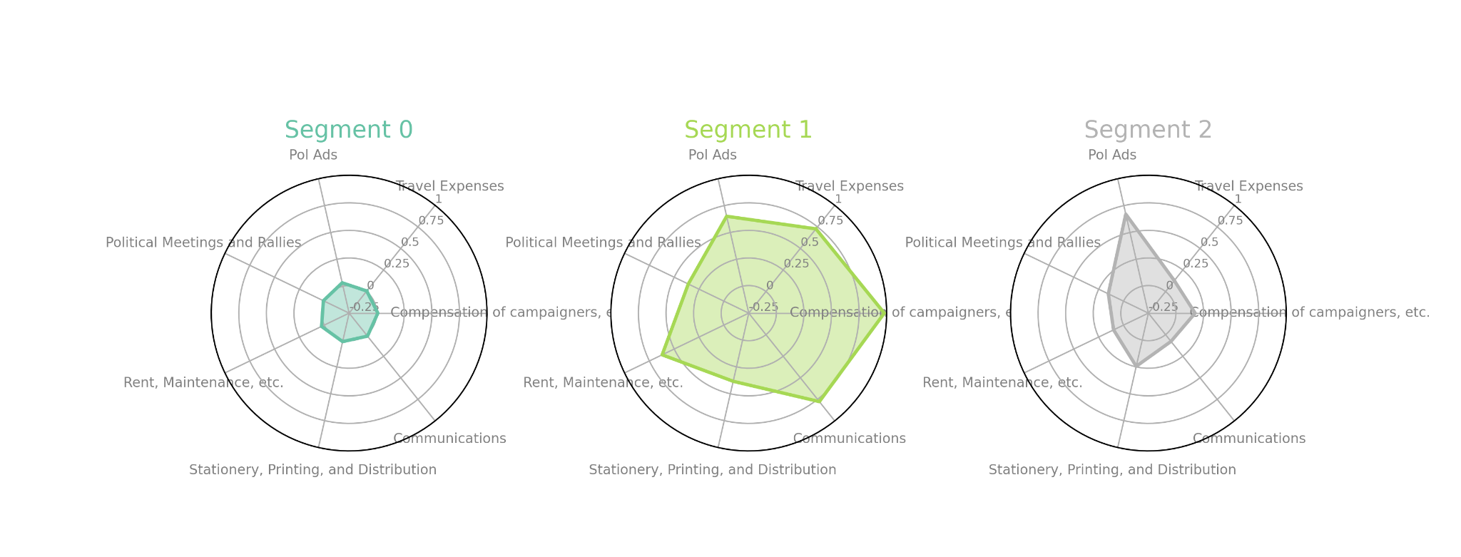
Clustering by expenditure breakdown
2 out of 48 won
Spent less overall
1 out of 2 won
Spent more on all general campaign expenditures
9 out of 12 won
Spent more focusing on political advertisements
Notes:
Segment 0 consists of 48 candidates, of whom, 2 won. Segment 1 consists of 2 candidates, 1 won while 1 lost. Lastly, Segment 2 consists of 12 candidates, 9 of whom won a seat in the senate. As seen in the radar chart, Segment 0 are candidates who spent less for the elections relative to the whole group. Segments 1 and 2 are candidates who spent the most - with Segment 1 consisting of candidates whose expenditure are spread throughout all aspects while Segment 2 consisting of candidates whose expenditure are focused on Political Advertisements.

Slide 17
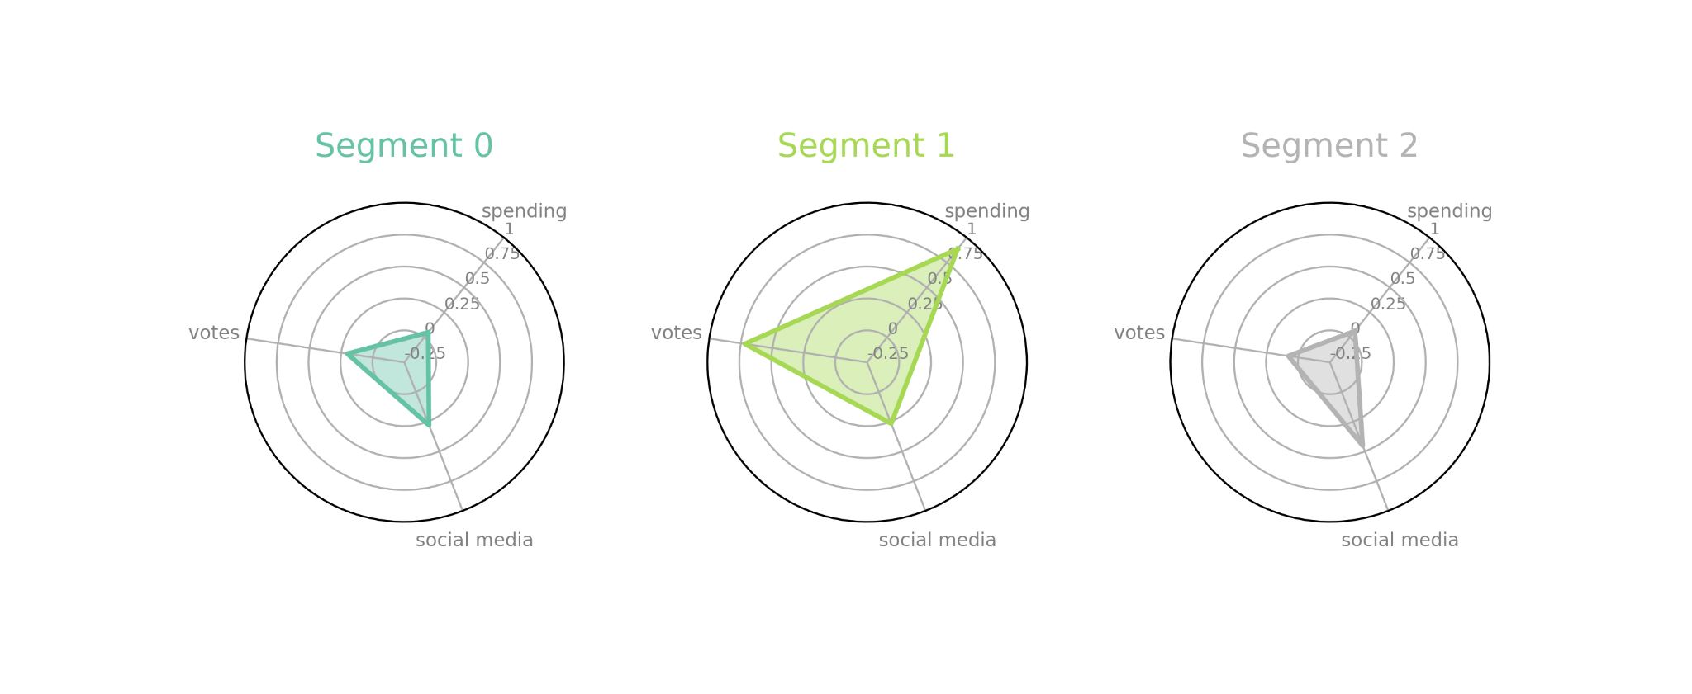
Spending in general
Same with slide before but diff format, can add/ remove these

Slide 18
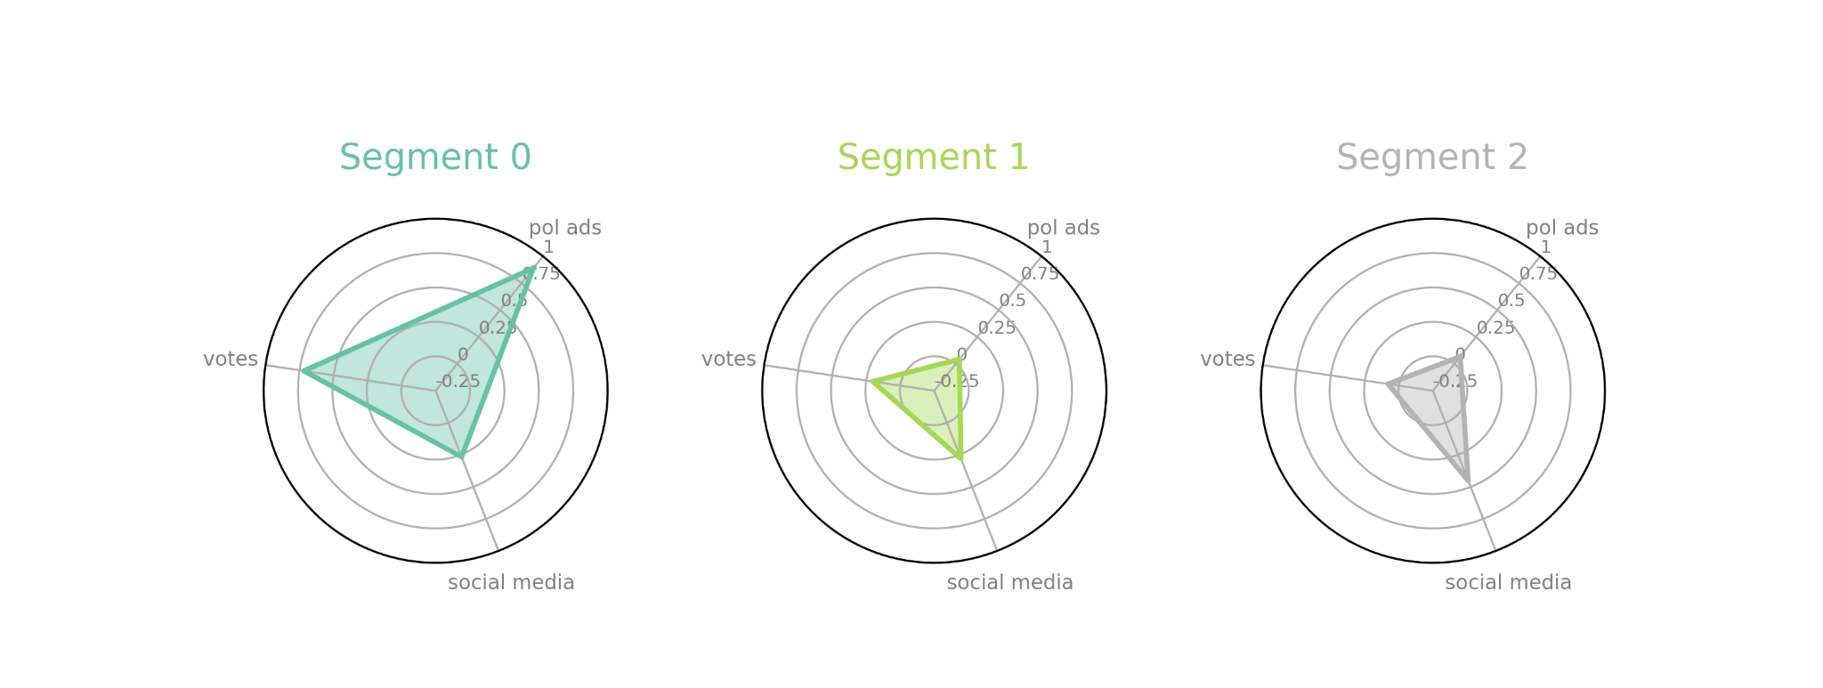
Cluster with Just Pol ads, spend to votes
Notes:
Cluster 1 - It is shown in this cluster that a candidate with high votes had high spending, but with moderate social media interactions
While Cluster 0 shows that candidate moderate votes with moderate votes, 25%
In Cluster 2, however, we can see that even a candidate has high social media interaction, they do not have high votes, which justifies the low correlation of votes to social media interactions.

Slide 19
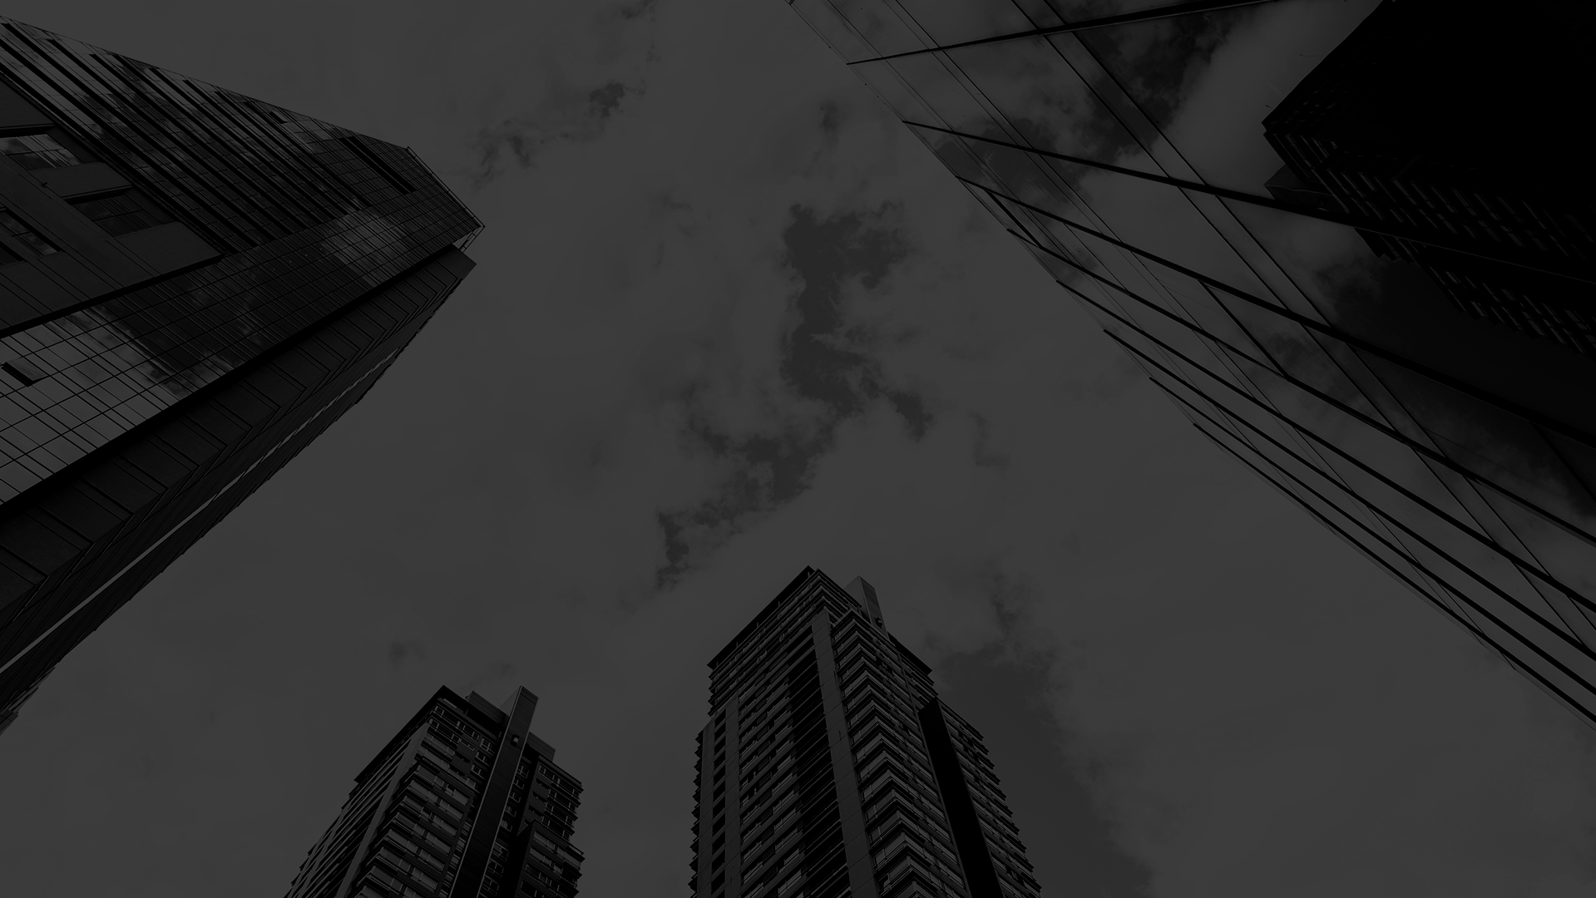
Conclusion and Recommendations

Slide 20
Conclusions
There is a high association between candidate votes and spending (R=0.78).
Results of our analyses imply that spenders may get voter reach from political advertisements (91%), while non-spenders only from social media (9%).
This shows that non-spenders are missing out on significant voter reach during the election.
Notes:
In this regard, we recommend the ff --

Slide 21
Conclusions
Voters are also affected given their options are narrowed down only to candidates who spent on political campaigns.
While non-spenders may prove to be great leaders, their candidacy remain unknown to the general public.
Notes:
In this regard, we recommend the ff --

Slide 22
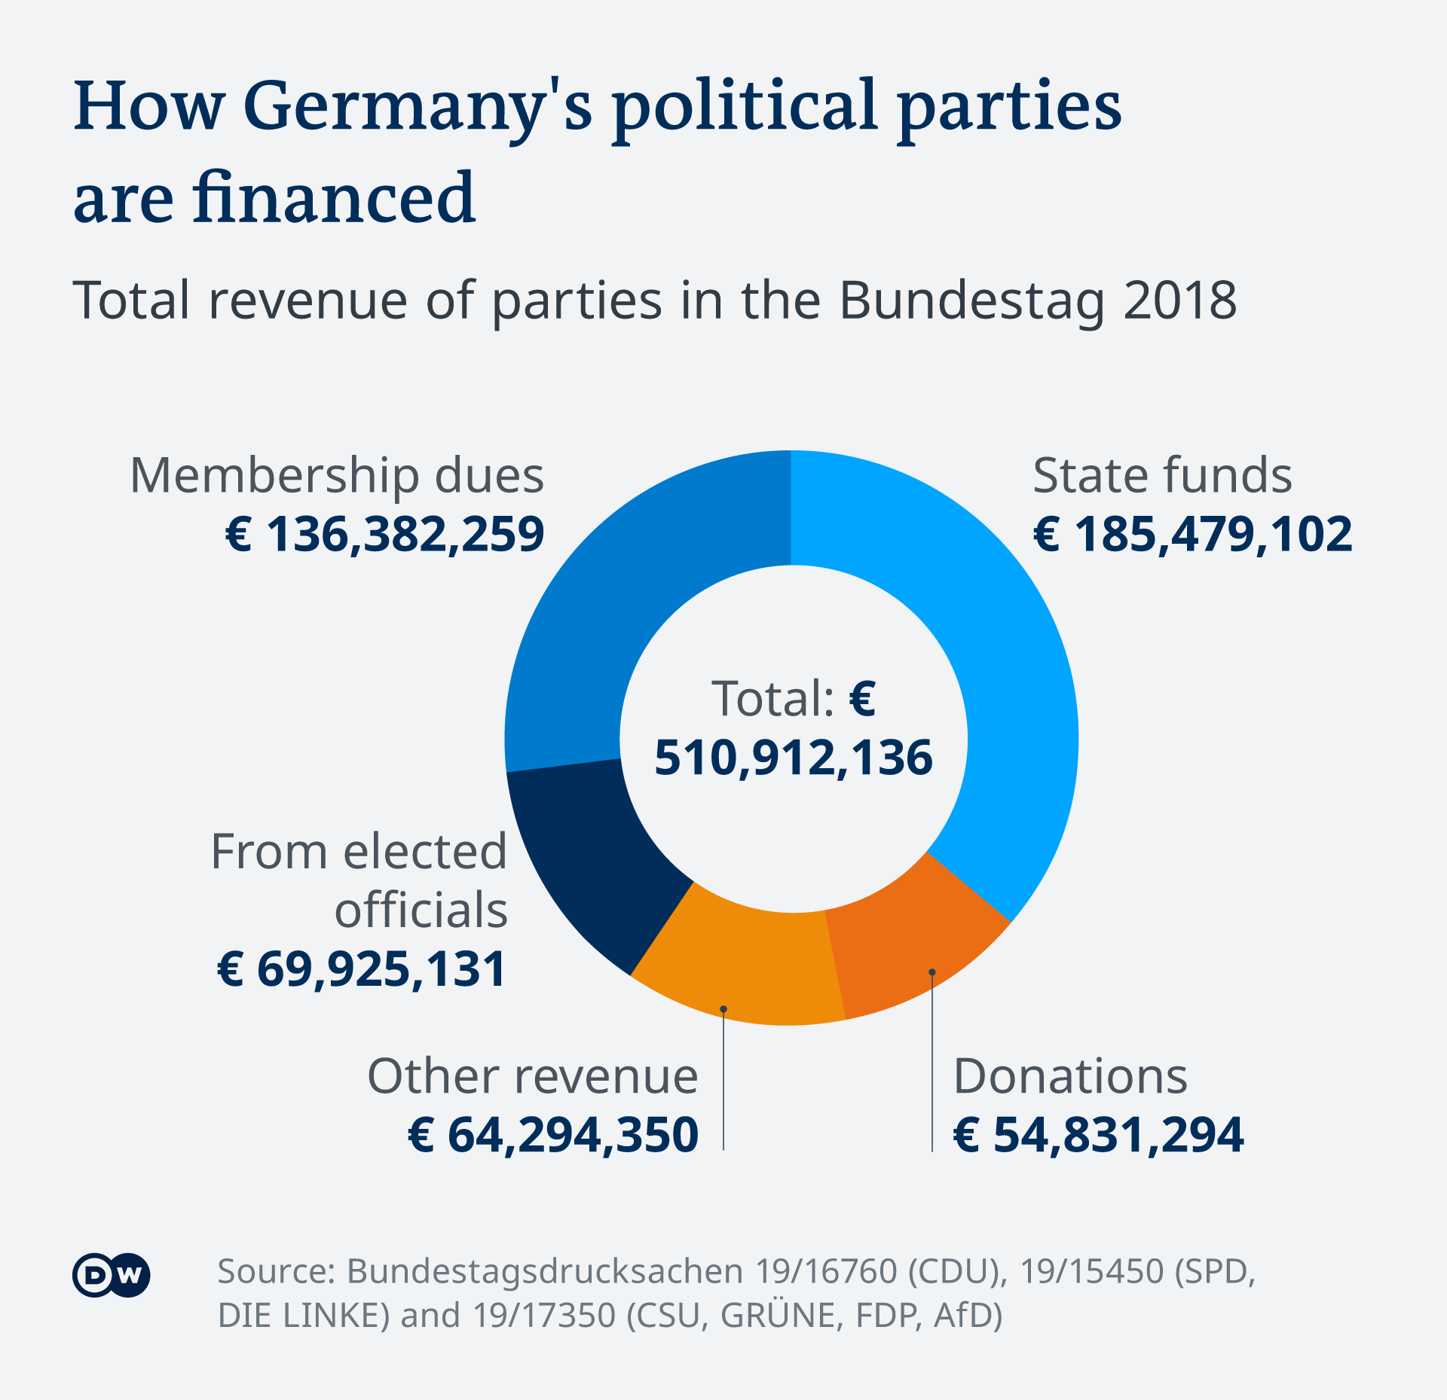
Recommendations
In the Philippines, candidates are mostly funded by a few backers.
Government funding might resolve this issue.
https://www.dw.com/en/german-election-party-and-campaign-financing/a-58807353
Notes:
To even the playing field, government funding can be provided to candidates. In Germany, parties receive funding in proportion to the votes they received.
While this system favor incumbents and can be tweaked further for fairness, the results speak for themselves. Donations comprise barely 10% of the total expenditures whereas in the Philippines, the PCIJ stated candidates are mostly funded by a few backers.

Slide 23

Given that political ads played a factor in the 2019 PH elections, allotting ad time for candidates should be considered.
People vector created by pch.vector - www.freepik.com
Notes:
Ad air time is also partitioned by vote share in Germany. Given that political ads played a factor in the 2019 PH elections, allotting time for candidates should also be considered.

Slide 24
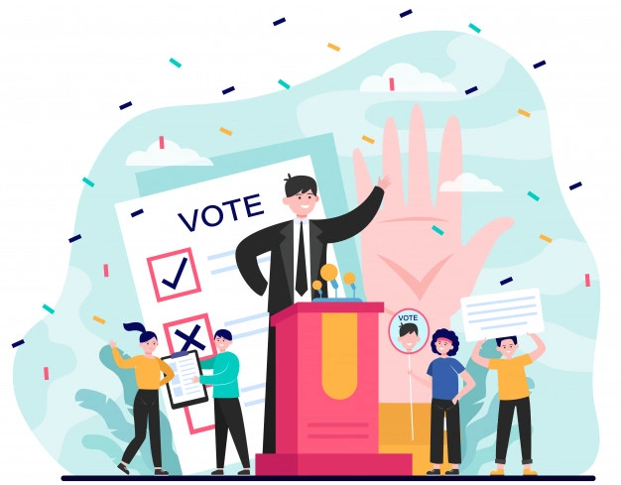
2020 Brazil Mayoral Elections
Limit set 70% of the previous election
~900,000 Php
Abstract vector created by pch.vector - www.freepik.com
Notes:
Competitiveness and reelection rates were reduced in the 2020 Brazil mayoral elections when expenditure limits were put in place. Overall spending was also limited as a result. It is important to watch out for unaccounted funds or dark money however. Thus, limits should be paired with good accounting practices.
It is important to note that these measures are tailor fitted to these countries. The Philippines has to figure out its own blend of election policies and checks.

Slide 25

Establish spending limits and fiscal transparency to increase competitiveness and reduce incumbency advantage.
Money vector created by studiogstock - www.freepik.com
Notes:
Competitiveness and reelection rates were reduced in the 2020 Brazil mayoral elections when expenditure limits were put in place. Overall spending was also limited as a result. It is important to watch out for unaccounted funds or dark money however. Thus, limits should be paired with good accounting practices.
It is important to note that these measures are tailor fitted to these countries. The Philippines has to figure out its own blend of election policies and checks.

Slide 26

To improve our study, we plan to look at more extensive datasets to learn more about:
Candidate background (profiles)
Detailed expenses
Political advertisements
Voter demographics and participation per Region, Province (2019).
Data vector created by stories - www.freepik.co
Notes:
To have more robust analysis, detailed datasets on political ad spending per media, travel, and others could be explored.

Slide 27
References
Ilagan , Karol, & Simon, Floreen. (n.d.). Covering campaign finance: The Philippine experience. Philippine Center for Investigative Journalism. Retrieved November 26, 2021, from https://pcij.org/article/5377/covering-campaign-finance-philippine-experience.
Hallam, M. H., & Bateson, I. (n.d.). German election: Party and campaign financing: DW: 09.08.2021. DW.COM. Retrieved November 26, 2021, from https://www.dw.com/en/german-election-party-and-campaign-financing/a-58807353.
Avis, E., Ferraz, C., Finan, F., & Varjão, C. (2021, July). Money and Politics: The Effects of Campaign Spending Limits on Political Entry and Competition. Econometrics Laboratory, UC Berkeley. Retrieved November 26, 2021, from https://eml.berkeley.edu/~ffinan/Finan_Limits.pdf.

